Slide 1
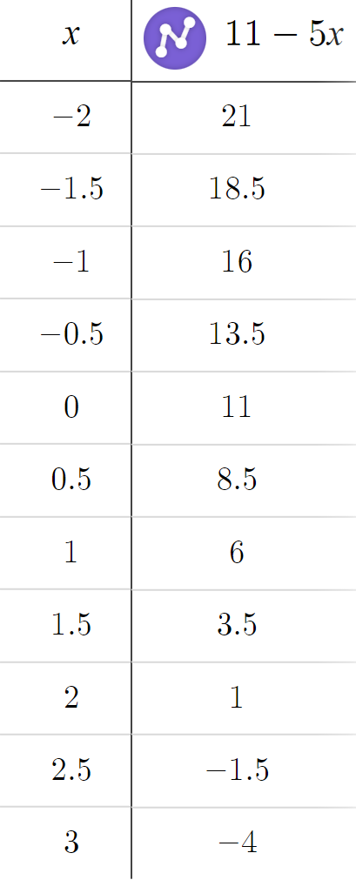
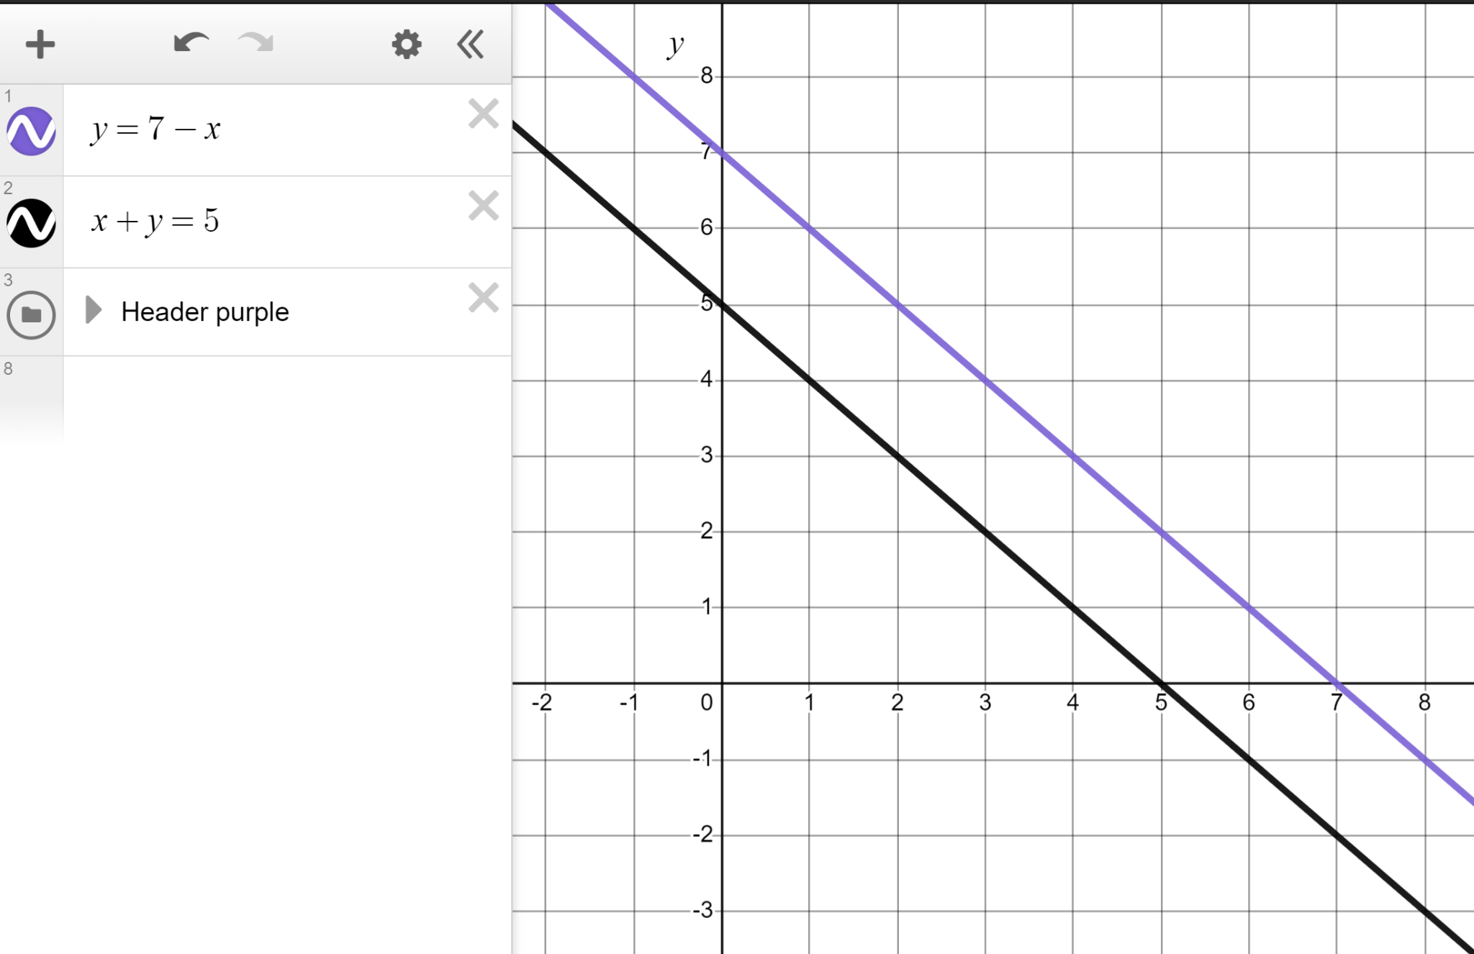
Exploring the shapes of graphs using technology
Task A: Reviewing plotting graphs of equations
1) Create a table of values to plot the linear graph of y = 11 − 5x for x-values in the range −2 ≤ x ≤ 3 in steps of 0.5
2)
a) Without using a table plot the linear graph of y = 7 − x
b) Without using a table plot the linear graph of x + y = 5
x + y − x = 5 − x
y = 5 − x
c) What do you notice about the shape of the two graphs?
Write a sentence.
You might have written:
Both are linear graphs. Both have a gradient of −1 making them parallel.

Slide 2
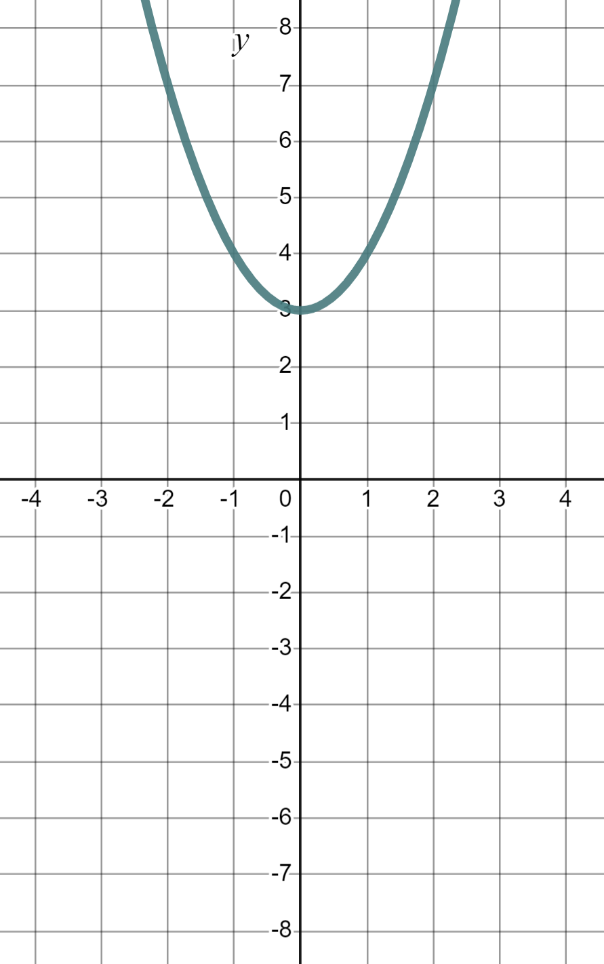
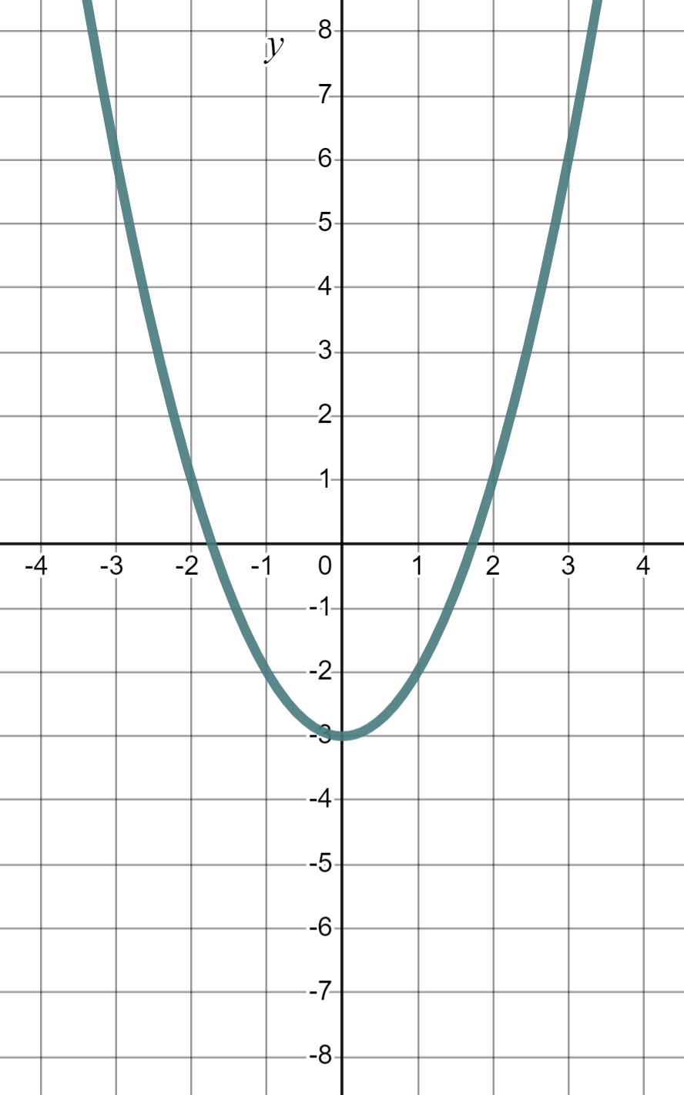
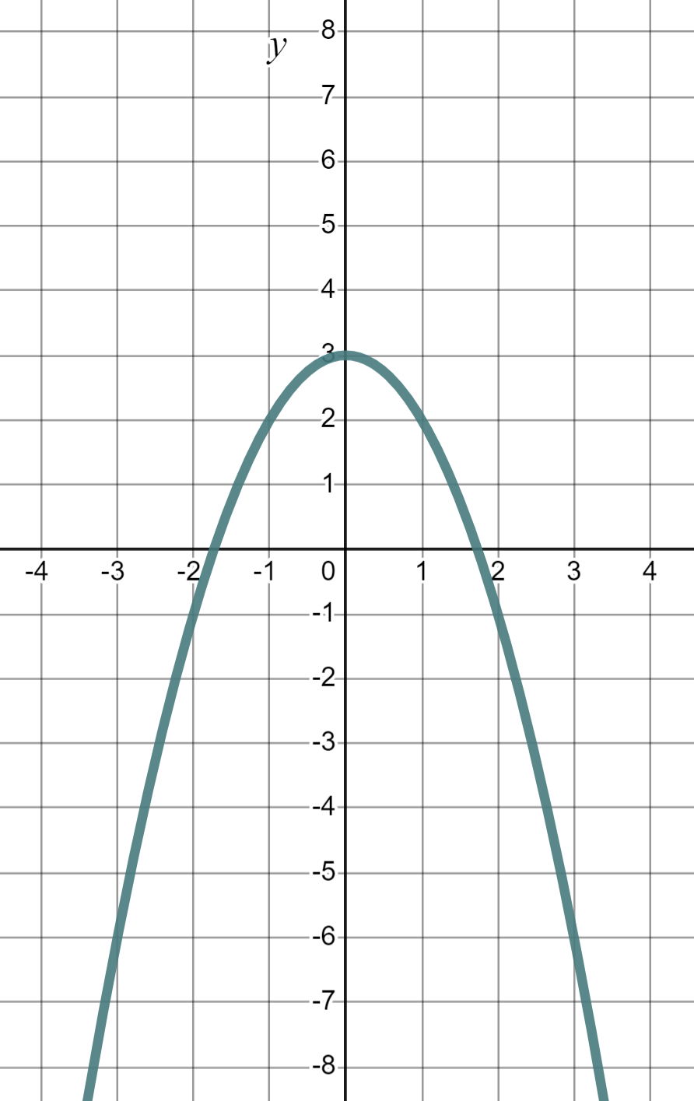
Exploring the shapes of graphs using technology
Task B: Plotting quadratic graphs
1) Categorise these equations into quadratic, linear, and ‘other’.
Quadratic
b) y = x² − 5
d) y = x² − x + 5
e) y = x² − 5x
f) y = x² − 5x + 1
h) y = 5 + x²
k) y = x(x + 2)
Linear
a) y = x − 5
g) y = 5 + 2x
j) y = 5(x + 2)
‘Other’
c) y = x⁴ − 5
i) y = x⁵ + x²
l) y = x(x² + 2)
2) Use technology to plot the graphs of these quadratic equations. They all form parabolas. Spot the odd one out.
a) y = x² + 3
b) y = 3 + x²
c) y = x² − 3
d) y = 3 − x²
a) and b) Addition is commutative, hence the same graph.
×
You might have said,
“d) is the one out. It is upside down”.
Whilst it is very different it is still a parabola. It looks upside down but we would tend to say it “Opens downwards” or is ‘⋂-shaped’. Importantly, we still have a quadratic equation and a parabola.
You might have said, “c) is the odd one out because it is the only one with a negative y-intercept”.
Mathematics in Education and Industry
v2.3

